Slide 1
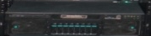
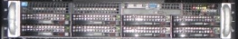
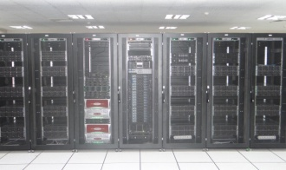
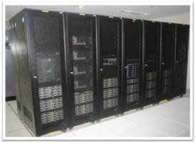
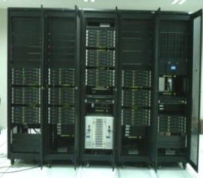
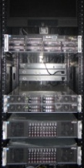
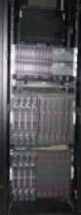


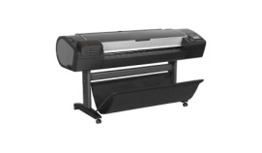
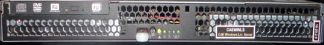

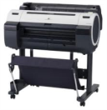
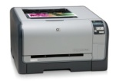
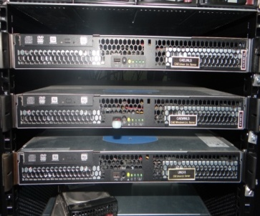

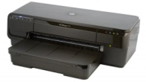
400 Node cluster
134 Node cluster
128 Node cluster
SMP Servers
Blade Cluster
GPU Cluster
NAS Servers
LDAP server
xeonsmp1
Server 1
LDAP Server
xeonsmp 2
winsmp
Server 2
LDAP B/U
WORKSTATIONS
SWITCH
LICENCE SERVERS
GWSD - 1
PRINTERS
CAELINLS
GWSD - 2
SWITCH 1
HP Design jet Z5400 Ps
CAEWINLS
GWSD - 3
SWITCH 2
GWSD - 4
LINLS-3
GWS - 1
Canon iPF 750
FIREWALL
GWS - 2
WINLS-TEMP
GWS -3
HP color Laser jet CP1515n
HPC FIRE
GWS -5
HPC FIRE-1
GWS -6
HP Office Jet 7110
GWS -7
GWS -8
Campus
Backbone
GWS -10
GWS -12
GWS -13
GWS -14

